Slide 1
Database Normalization
Exercises
数据库规范化练习

Slide 2
What is Normalization? 什么是标准化？
Normalization is a database design technique that reduces data redundancy and eliminates undesirable characteristics like Insertion, Update and Deletion Anomalies. 规范化是一种数据库设计技术，它减少了数据冗余，消除了诸如插入、更新和删除异常等不需要的特性
Normalization rules divides larger tables into smaller tables and links them using relationships. 规范化规则将较大的表划分为较小的表，并使用关系将它们链接起来
The purpose of Normalisation is to eliminate redundant (repetitive) data and ensure data is stored logically 标准化的目的是消除冗余（重复）数据，并确保数据以逻辑方式存储

Slide 3
What is Normalization? 什么是标准化？
The inventor of the relational model (Edgar Codd) proposed the theory of normalization of data with the introduction of the 1NF, and he continued to extend theory with 2NF and 3NF. Later he joined (Raymond F. Boyce) to develop the theory of (Boyce-Codd Normal Form). 关系模型（Edgar Codd）的发明者通过引入1NF提出了数据规范化理论，并继续用2NF和3NF扩展了该理论。后来他加入了（ Raymond F. Boyce) 发展理论 (Boyce-Codd Normal Form).

Slide 4
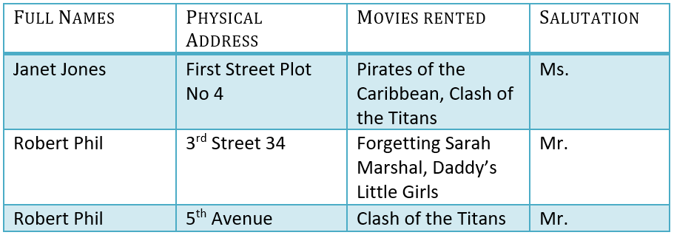
Exercise 1
Database Normalization can be easily understood with the help of a this exercise. Assume, a video library shop maintains a database of movies rented out. Without any normalization in database, all information is stored in one table as shown below. 在本练习的帮助下，可以很容易地理解数据库规范化。假设，一家视频库商店维护着一个出租电影的数据库。在数据库中没有任何规范化，所有信息都存储在一个表中，如下所示。
Q1a: Create the 1NF for this relationship model Q1a：为这个关系模型创建1NF

Slide 5
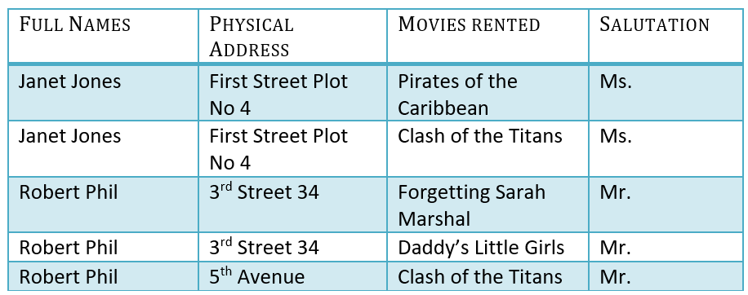
Answer of Q1a
Q1a答案
1NF (First Normal Form) Rules 1NF 规则
  Each table cell should contain a single value. 每个表单元格应包含一个值
  Each record needs to be unique. 每个记录都必须是唯一的

Slide 6
2NF
Q1b: Create the 2NF for this relationship model
Q1b：为这个关系模型创建2NF

Slide 7
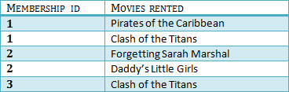

Answer of Q1b Q1b答案
2NF (Second Normal Form) Rules 2NF 规则
  Rule 1- Be in 1NF 规则1-在1NF中
  Rule 2- Single Column Primary Key 规则2-单列主键
It is clear that we can't move forward to make our simple database in 2nd Normalization form unless we partition the table 很明显，除非我们对表进行分区，否则我们无法将我们的简单数据库变成第二种规范化形式
Rent (Table 2)
Members (Table 1)
We have divided1NF table into two tables. Table 1 (Members) and Table2 (Rent). Table 1 contains member information. Table 2 contains information on movies rented.
We have introduced a new column called Membership_ID which is the primary key for table 1. Records can be uniquely identified in Table 1 using membership_ID
我们引入了一个名为Membership\ ID的新列，它是表1的主键。可以使用Membership\ ID在表1中唯一地标识记录

Slide 8
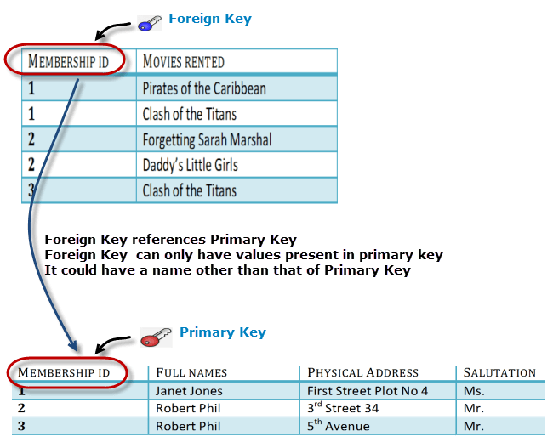
Foreign Key
Foreign Key references the primary key of another Table! It helps connect Tables 外键引用另一个表的主键！它有助于连接表格

Slide 9
Problems in 2NF 2NF中的问题
You will only be able to insert values into your foreign key that exist in the unique key in the . This helps in referential integrity. 只能将存在于中唯一键中的值插入到外键中。这有助于参照完整性
The above problem can be overcome by declaring Membership_ID from Rent table as foreign key of Membership_ID from Members table. 通过将rut表中的membershid声明为Members表中的成员ID的外键，可以克服上述问题
Now, if somebody tries to insert a value in the Membership_ID field that does not exist in the Members table, an error will be shown! 现在，如果有人试图在Members表中不存在的membershid字段中插入一个值，将显示一个错误！

Slide 10
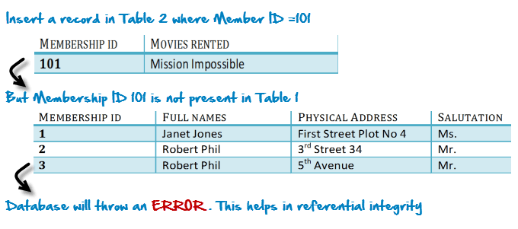
Problems in 2NF
Suppose, when inserts a record in Rent such as Member_ID = 101 假设，在Rent中插入一个记录，例如Member\u ID=101

Slide 11
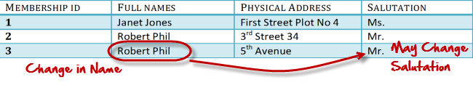
What are transitive functional dependencies?
什么是传递函数依赖？
A transitive functional dependency is when changing a non-key column, might cause any of the other non-key columns to change 可传递函数依赖关系是指在更改非键列时，可能会导致其他任何非键列发生更改
Consider the Members table. Changing the non-key column Full Name may change Salutation. 考虑Members表。更改非键列的全名可能会更改称呼语

Slide 12
3NF
Q1c: Create the 3NF for this relationship model
Q1c：为这个关系模型创建3NF

Slide 13

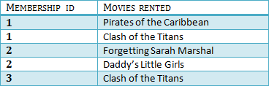

Answer of Q1c Q1c答案
3NF (Third Normal Form) Rules 3NF 规则
  Rule 1- Be in 2NF 规则1-在2NF中
  Rule 2- Has no transitive functional dependencies 规则2-没有可传递的函数依赖项
To move our 2NF table into 3NF, we again need to again divide our table. 要将2NF表移到3NF，我们需要再次划分表。
We have again divided our tables and created a new table which stores Salutations. There are no transitive functional dependencies, and hence our table is in 3NF 我们再次划分了我们的表格，并创建了一个新的表，存储敬礼。没有传递函数依赖项，因此我们的表是3NF
In Table 3 Salutation_ID is Primary key, and in Table 1 Salutation_ID is Foreign to primary key in Table 3 在表3中，称呼\u ID是主键，在表1中，称呼\u ID与表3中的主键无关

Slide 14
Answer of Q1d 的答案 Q1d
4NF (Fourth Normal Form) Rules 4NF 规则
  If no database table instance contains two or more, independent and multivalued data describing the relevant entity, then it is in 4th Normal Form. 如果没有一个数据库表实例包含两个或多个描述相关实体的独立多值数据，那么它就是第四范式。

Slide 15
Exercise 2 练习2
Q2: Create the 2NF for this relationship model 问题2：为这个关系模型创建2NF
Customer | Customer Address | Product | Product Manufacturer | Quantity | Order Date
Bob Smith | 123 Broadway Dr | Basketball | Spaulding | 1 | 8/9/2020
Bob Smith | 123 Broadway Dr | Bat | Louisville Slugger | 2 | 8/9/2020
Jill Thomas | 12 Kellogg Ave | Bat | Louisville Slugger | 1 | 8/10/2020
Mark Smith | 5 Maple Street | Golf Balls | Titleist | 2 | 8/12/2020
Mark Smith | 5 Maple Street | Basketball | Titleist | 2 | 8/12/2020

Slide 16
Exercise 2 Answer 练习2答案
Customer | Customer Address | Product | Product Manufacturer | Quantity | Order Date
Bob Smith | 123 Broadway Dr | Basketball | Spaulding | 1 | 8/9/2020
Bob Smith | 123 Broadway Dr | Bat | Louisville Slugger | 2 | 8/9/2020
Jill Thomas | 12 Kellogg Ave | Bat | Louisville Slugger | 1 | 8/10/2020
Mark Smith | 5 Maple Street | Golf Balls | Titleist | 2 | 8/12/2020
Mark Smith | 5 Maple Street | Basketball | Titleist | 2 | 8/12/2020
F-Key Customer | F-Key Product | Order Date | Quantity
Bob Smith | Basketball | 8/9/2020 | 1
Bob Smith | Bat | 8/9/2020 | 2
Jill Thomas | Bat | 8/10/2020 | 1
Mark Smith | Golf Balls | 8/12/2020 | 2
Mark Smith | Basketball | 8/12/2020 | 2
P-Key Customer | Customer Address
Bob Smith | 123 Broadway Dr
Jill Thomas | 12 Kellogg Ave
Mark Smith | 5 Maple Street
P-Key Product | Product Manufacturer
Basketball | Spaulding
Bat | Louisville Slugger
Golf Balls | Titleist
Basketball | Titleist

Slide 17
Exercise 3 练习3
Q3: Create the 3NF for this relationship model
问题3：为此关系模型创建3NF
Product | Product Manufacturer | Product Manufacturer Address | Product Details | Product Cost
Basketball | Spaulding | 1 Spaulding Drive | 23.5 Inch | $25
Bat | Louisville Slugger | 23 Rawling court | 33 Inch | $35
Golf Balls | Titleist | 23 Rawling Court | 4 Pack | $6
Basketball | Titleist | 1234 Titlest Road | 1 Dozen | $44

Slide 18
Exercise 3 Answer 练习3答案
Product | Product Manufacturer | Product Manufacturer Address | Product Details | Product Cost
Basketball | Spaulding | 1 Spaulding Drive | 23.5 Inch | $25
Bat | Louisville Slugger | 23 Rawling court | 33 Inch | $35
Golf Balls | Titleist | 23 Rawling Court | 4 Pack | $6
Basketball | Titleist | 1234 Titlest Road | 1 Dozen | $44
Product Manufacturer Table
P-Key Product Manufacturer | Product Manufacturer Address
Spaulding | 1 Spaulding Drive
Louisville Slugger | 23 Rawling court
Titleist | 23 Rawling Court
Titleist | 1234 Titlest Road
P-Key Product | F-Key Product Manufacturer | Product Details | Product Cost
Basketball | Spaulding | 23.5 Inch | $25
Bat | Louisville Slugger | 33 Inch | $35
Golf Balls | Titleist | 4 Pack | $6
Basketball | Titleist | 1 Dozen | $44
Product Table

Slide 19
Exercise 4 练习4
Q4: Create the 4NF for this relationship model
问题4：为这个关系模型创建4NF
Customer | Customer Address | Customer Email Address | Customer Email Subscription
Bob Smith | 123 Broadway Dr | bsmith@gmail.com | Baseball, Basketball
Jill Thomas | 12 Kellogg Ave | jtomas@gmail.com | Baseball
Bill Smith | 5 Maple Street | Smith5#hotmail.com | Golf

Slide 20
Exercise 4 Answer 练习4答案
Customer | Customer Address | Customer Email Address | Customer Email Subscription
Bob Smith | 123 Broadway Dr | bsmith@gmail.com | Baseball, Basketball
Jill Thomas | 12 Kellogg Ave | jtomas@gmail.com | Baseball
Bill Smith | 5 Maple Street | Smith5#hotmail.com | Golf
Customer | Customer Address | Customer Email Address | Customer Email Subscription
Bob Smith | 123 Broadway Dr | bsmith@gmail.com | Baseball
Bob Smith | 123 Broadway Dr | bsmith@gmail.com | Basketball
Jill Thomas | 12 Kellogg Ave | jtomas@gmail.com | Baseball
Bill Smith | 5 Maple Street | Smith5#hotmail.com | Golf
P-Key Customer | Customer Address | Customer Email Address
Bob Smith | 123 Broadway Dr | bsmith@gmail.com
Jill Thomas | 12 Kellogg Ave | jtomas@gmail.com
Bill Smith | 5 Maple Street | Smith5#hotmail.com
F-Key Customer | Customer Email Subscription
Bob Smith | Baseball
Bob Smith | Basketball
Jill Thomas | Baseball
Bill Smith | Golf

